Slide 1
Diagnosing and Resolving J2EE Application Issues Before Deployment
Ferhan Kilical, Ph.D. CSSGB
Kwok Fung Au Yeung, MS. CSSGB

Slide 2
Background
eRedEye is a Washington DC based IT consultancy company focuses on performance testing, system testing, data design and business processes reengineering. We deliver high quality managed strategies and software testing solutions to systematically locate weaknesses within the complexity of any IT system and provide clients with accurate information on risks, issues and milestones throughout the project lifecycle.

Slide 3
About Speakers
Ferhan Kilical is an experienced IT professional with more than 20 years of software development and engineering experience. In her early career years, she successfully managed high profile projects in Department of Defense. She founded eRedEye Consultancy in 2004 in Washington DC. The areas of expertise are; automated testing tools, functional, performance, security and SOA testing. Ferhan is 2006 Mercury Business Technology Optimization Award finalist.
Stanley Au Yeung is a senior performance and capacity planning specialist. He has his MS degree from George Washington University in Information Technology. He is responsible for capacity and performance testing processes for eRedEye client’s critical systems.

Slide 4
Introduction
Deploying high performance distributed multi-tiered Java applications into production can be unbearably difficult, yet you can't afford to turn your back on the process.
With the size and complexity of most Java applications, it's getting much more important to get an early handle on performance.
Smart IT professionals are turning to technologies more than ever to measure, monitor, diagnose, and resolve critical problems before going into production.
We are going to explain how to diagnose and resolve J2EE application issues by performing scalability testing, performance testing, and optimization before deployment.

Slide 5
Challenges for J2EE Application Testing
J2EE offers many advantages to developers, but introduces new challenges for the development, performance diagnosis, tuning, deployment, and management of applications.
Successful delivery and management of typically complex J2EE-based applications requires evaluating performance throughout the entire application lifecycle.
J2EE components usually require some tuning before they communicate efficiently, and tuning several interdependent components is difficult and time consuming without a proper approach.
A lack of tools for diagnosing application performance and memory issues also increase the complexity and cost of development and deployment.

Slide 6
Challenges for J2EE Application Testing
Our goal is to provide an effective understanding, and strategy for analyzing performance problems, and steps to remediation and validation before application deployment.
  Effective Instrumentation for J2EE Application
  Diagnosing J2EE Application Logic Problems
  Diagnosing J2EE Configuration Problems

Slide 7

Process for Diagnosing
Planning - Assess performance objectives and current application performance. Define testing resources, infrastructure, and monitoring requirements. Assess targeted workload on application and define business processes.
Prepare - Setup testing, monitoring, and diagnostics infrastructure. Develop business process scripts, runtime settings, and scenarios to meet required workload targets.
Baseline - Validate workload and calibrate if necessary with targeted workload characteristics.
Optimize - Execute performance tests, and validate load accuracy. Analyze and process real-time and post-analysis data. Determine appropriate strategy to analyze, and remediate issues and perform change impact analysis of recommendations.
Synopsis - Review performance objectives and goals achieved. Ready for deployment.

Slide 8
Define the Workload
The easiest way to make a representative workload is by collecting information of the actual usage scenario in production.
Identify pattern of URLs and HTTP requests that corresponds to the different web pages and functionalities of the application.
This workload information can be used in both developing performance test scripts and test scenarios.

Slide 9
Establishing Baseline
The purpose of the baseline is to establish a point of reference from which all other load tests will be compared to.
Run the workload without any profiling tools attached, collect the target metric, and repeat.
Repeat the tests at least three times or more.
  It may be useful to run a set of tests to record the impact of rebooting the servers, re-starting the application server processes.

Slide 10
Establishing a Baseline
Guidelines –
Validate script execution – ensure updates in front-end are committed in back-end.
Verify proper test data manipulation – ensures that virtual users are injecting realistic and non-reoccurring data into system so that system is properly stressed.
Verify script concurrency – ensures that all scripts participating in load test are working without any concurrency or race-condition issues.

Slide 11
Establishing a Baseline
Model workload based on actual production activity –it ensures that the performance testing effort is focused on the right business processes and in the right quantity and rates.
Do not enable any diagnostics during initial baseline. Monitoring should be enabled on-demand based on analysis and root-cause identification requirements.
Ensure all activity on the system under test is accounted. If batch or background processes are activity, they should be activity for all test runs.

Slide 12
Optimization process
Once a baseline is established an iterative process should be employed to isolate and diagnose bottlenecks, remediate, and fine-tune performance.
Once one area of the application improves, another area will become a bottleneck. Cyclic process must be repeated until the desired goal has been reached.
Bottleneck identification requires in-depth analysis of each test result and monitoring data collected from performance test. Insufficient depth of monitoring information requires revision of monitoring or instrumentation strategy

Slide 13
Monitoring Infrastructure and J2EE Environment Problems
Start with network infrastructure and components (load balancers, firewall, network switches). Problems in this tier should be handled first.
Monitor and track high-level performance metrics at each tier (web, application, database). Problems in front-end servers should be addressed before back-end servers.
Incrementally increase monitoring depth and detail in layers where high-level monitors indicate potential bottlenecks.

Slide 14
Monitoring Infrastructure and J2EE Environment Problems
Analyze online data when users have ramped up and stabilized. Sudden spikes in load my exhibit only transient problems that may clear out as user load stabilizes. These transient problems should be ignored. However, if problem persists with steady load, it needs to be investigated.
Compare load versus performance graphs (ie. running users vs average response time, application server queue length with average response times, etc), to isolate problematic tiers.
Ensure appropriate application architects/experts and system administrators are available for aiding in identifying and diagnosing problems.

Slide 15
Important Server Monitors
CPU | System: Processor queue length | Processor queue length indicates the number of threads in the server's processor queue waiting to be executed by the CPU. As a rule of thumb, if the processor queue remains at a value higher than 2 for an extended period of time, most likely, the CPU is a bottleneck.
 | Processor: Percent of processor time | This counter provides the total overall CPU utilization for the server. A value that exceeds 70-80 percent for long periods indicates a CPU bottleneck.
 | System: Percent of total privileged time | This counter measures what percentage of the total CPU execution time is used for running in kernel/ privileged mode. All the I/O operations run under kernel mode, so a high value (about 20-30 percent) usually indicates problems with the network, disk, or any other I/O interface.

Slide 16
Important Server Monitors
RAM | Memory: Pages per second | Pages per second are the number of pages read from or written to the disk for resolving hard page faults. A value that continuously exceeds 25-30 indicates a memory bottleneck.
 | Memory: Available bytes | Available bytes are the amount of physical memory available to processes running on the computer, in bytes. A low value (less than 10 MB) usually means the machine requires more RAM.
Hard disk | Physical disk: Average disk queue length | The average number of requests queued for the selected disk. A sustained value above 2 indicates an I/O bottleneck.
 | Physical disk: Percent of disk time | The percentage of elapsed time that the selected disk drive is busy servicing requests. A continuous value above 50 percent indicates a bottleneck with hard disks.

Slide 17
Understanding Key Graphs for Diagnosing Critical Issues
In this presentation, we use Mercury LoadRunner with J2EE Diagnostic as the tool to demonstrate key concept of J2EE analysis. Each graph provides valuable information that may be used in the identification of a problem and drilling down into root-cause. It is important to understand what these graphs provide and how they should be interpreted to minimize diagnostic efforts and maximize value gained.

Slide 18
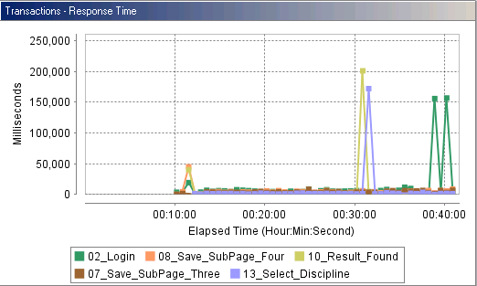
Understanding Key Graphs for Diagnosing Critical Issues
Transaction Response Time:
Notes:
The graph provides the ability to drill down from LoadRunner end-user transactions to low level methods on the application server across multiple JVMs. The graph quickly surfaces the longest duration transactions, and where most of the activity is being spent.
This graph can be used to drill down from a LoadRunner transaction name all the way down to the individual method call. From the expanded graph one would find the transaction that is showing high latency.

Slide 19
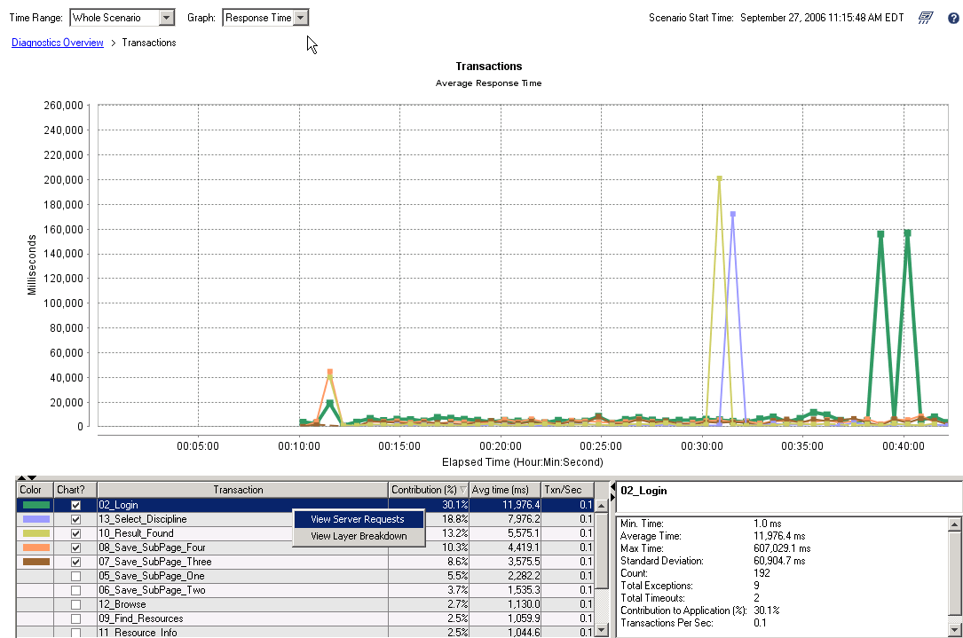
Understanding Key Graphs for Diagnosing Critical Issues
Notes:
The graph provides two choices: Server Request and Layer Breakdown. Use the Server Request page view when interested in drilling down to the high latency methods in Real-Time.

Slide 20
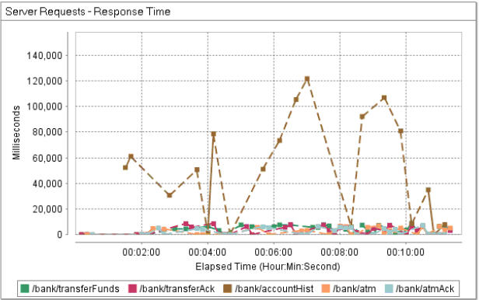
Understanding Key Graphs for Diagnosing Critical Issues
Server Response Time Graph
Notes:
The graph provides a view of top entry points to the application server. One can immediately see the where the highest contribution to response time is coming from. It allows for drill-down from web application server to JVM method invocations across multiple JVMs.

Slide 21
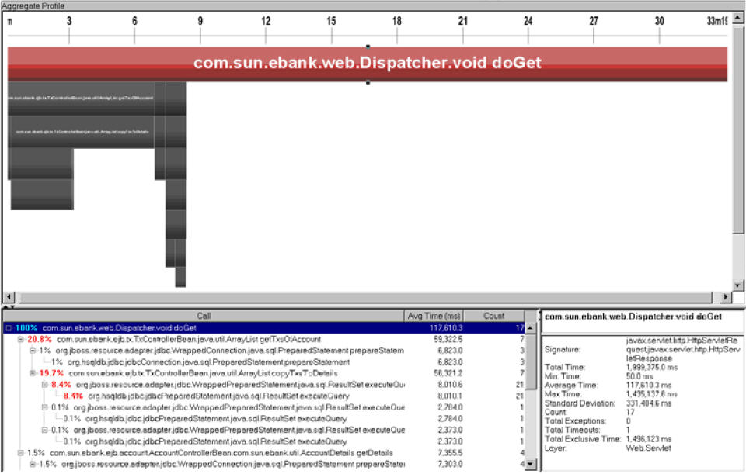
Understanding Key Graphs for Diagnosing Critical Issues
Breakdown of methods and call-stack
Notes:
Details in this view allow the user to determine the problematic method based on relative contribution to response time, and the layer to which it belongs.

Slide 22
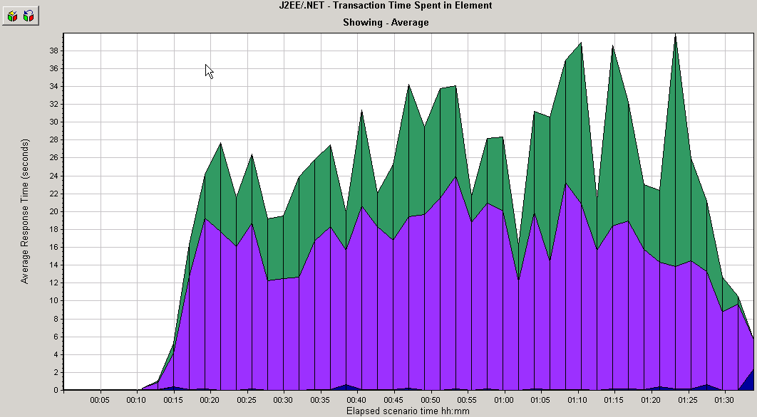

Understanding Key Graphs for Diagnosing Critical Issues
Top Application Layers
Notes:
it allows the user to quickly gauge which layer is the top consumer for the request and who should be engaged to assist in its resolution. If the JDBC layer is identified to be the largest portion of a request, then the appropriate database administrator and application developer should be consulted for identifying root-cause.

Slide 23
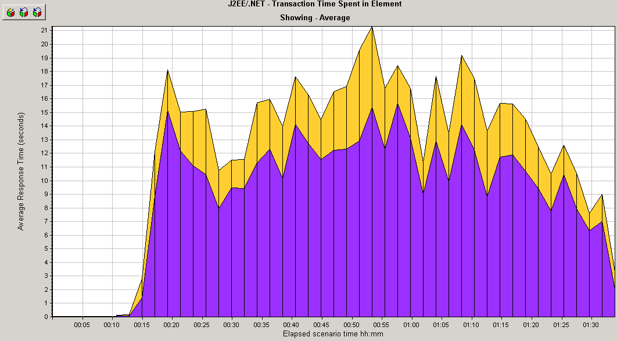
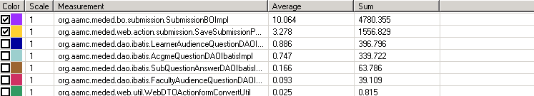
Understanding Key Graphs for Diagnosing Critical Issues
Class Level Breakdown

Slide 24
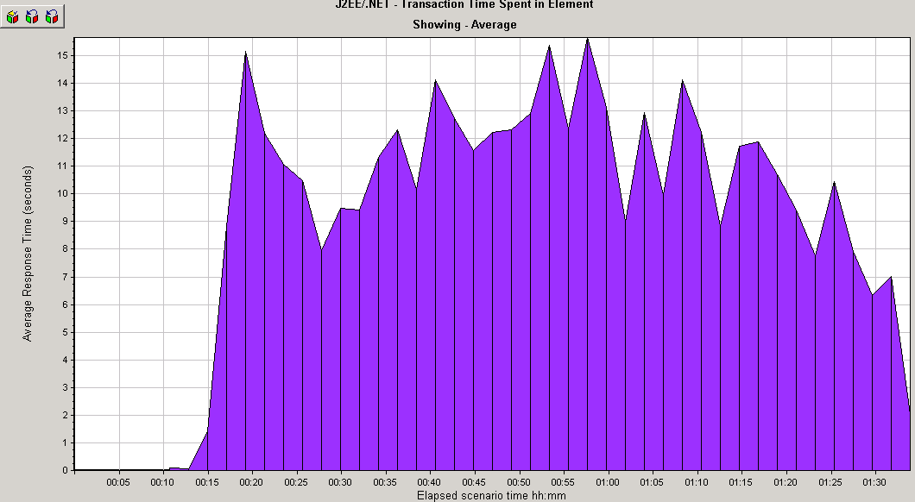
Understanding Key Graphs for Diagnosing Critical Issues
Method Level Breakdown

Slide 25
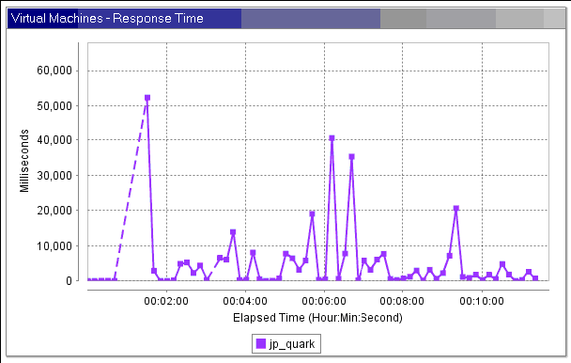
Understanding Key Graphs for Diagnosing Critical Issues
Virtual Machine
Notes:
The graph is used to understand the overall health of individual JVM’s and surface the top JVM’s in terms of overall average response times. In load balanced environments it is used to determine if load is evenly distributed or whether any particular JVM’s are overly stressed.

Slide 26
Environment Tuning
Majority of all performance issues are due to application configuration. Often applications are deployed on hardware or software infrastructure without proper configuration and testing.
The key to identifying configuration problem is to map specific method performance to discrete configuration parameters. The following illustrate a few common configuration issues:

Slide 27
Database Connection Pool Settings
A classical example of poor default JDBC connection pool settings is when user load increases, transaction response times increase, and “DataSource.getConnection()” response time increases correspondingly, however activity and load on the database is still low.
Increasing the JDBC pool size shortens the response time.
However, setting the JDBC connection pool too large might create more loads on the database. So care should be taken to set the size optimally with database capacity in mind.
Notes:
The principles applied to JDBC connection pool apply to all other types of pools (ie. thread pools, resource pools, etc.).

Slide 28
JVP Heap Tuning
Java virtual machines automate memory allocation, and use a technique called reachable objects to do garbage collection. When an object with a long life span keeps an unwanted reference to an unused object (like a static variable), you've got a leak.
By closely monitoring Heap Usage, we can identify if the maximum or minimum heap size is set appropriate to meet application requirements. An application has its heap size set too low, if its memory consumption is always close to its total heap size.
If an application has set its minimum heap size lower than optimal, the JVM has to regularly extend and reduce heap size – an expensive operation.
However it is not recommended to always set the minimum and maximum parameters to the same value if there is limited Memory (RAM), or server is shared by many other JVM instances, or –Xmx is very large and thus may cause significant slowdown during startup.
Notes:
An object is reachable if you can access it directly from some thread, or through a reference in another reachable object.
By setting the –Xms and –Xmx parameters to the same value, the heap size is pre-allocated and fixed during the startup and life of the application.

Slide 29
Web Server Tuning
Number of threads should be high enough to handle the maximum number of concurrent users, but not so high that it starts adding its own overhead of too many context switches.
Application servers tend to default to around 15 threads per virtual machine. If more than one instance of the application server is running, this number needs to be multiplied.
Do not load unnecessary modules.
Try to minimize logging as much as possible.
DNS reverse lookups are inefficient. Switch off DNS lookups in the configuration file.
Notes:
A context switch is the process of saving the machine state of one thread and loading the machine state of the next thread.
The optimum value can be determined by monitoring the number of threads in use during peak hours by making an HTTP request to Apache server with this URL: http:///server-status.
It displays how many requests are being processed and their status After the optimum value is determined, change the ThreadsPerChild directive in the configuration file to an appropriate value.
Do not load unnecessary modules. Apache allows dynamic modules that extend basic functionality of the Apache HTTP Server. Comment out all the LoadModule directives you don't need.
Try to minimize logging as much as possible. Look for directives LogLevel, CustomLog, and LogFormat in the configuration file for changing logging level.
DNS reverse lookups are inefficient. Switch off DNS lookups by setting HostnameLookups in the configuration file to off.

Slide 30
Application Tuning
The most popular way to optimize Java code is by using a profiler. Sun's JVM has built-in support for profiling (Java Virtual Machine Profiler Interface, or JVMPI). Many commercial profilers are also available
Be aware that all these profilers add significant overhead. Use these profilers with a single user or a limited number of users.
Avoid using synchronized blocks in your code as much as possible. Synchronized blocks can severely impair your application's scalability.

Slide 31
Application Tuning
Try to minimize the objects you store in HttpSession. Extra objects in http Session not only lead to more memory usage, they also add additional overhead for serialization/deserialization in case of persistent sessions.
Java stream objects perform better than reader/writer objects because they do not have to deal with string conversion to bytes.
Reduce the default session timeout either by changing your servlet container configuration or by calling http Session.setMaxInactiveInterval() in your code.
Always add directive <%@ page session="false"%> to JSP pages where you do not need a session.
Notes:
Use OutputStream in place of PrintWriter.

Slide 32
Conclusion
The most important lesson is the importance of a structured approach to optimization.
Evaluating your software environment from the top down and using the scientific method of one change per experiment is the most efficient use of your efforts.
Validate any changes made to the system to assess performance improvements and risks thus ensuring application functionality and stability isn’t prematurely compromised.
Performance issues should be tackled one at a time from highest priority down. Their resolution should be well documented for future use.

